Slide 1
Reconstruction of charge number of heavy cosmic rays using Cherenkov Light
Robert Stein

Slide 2
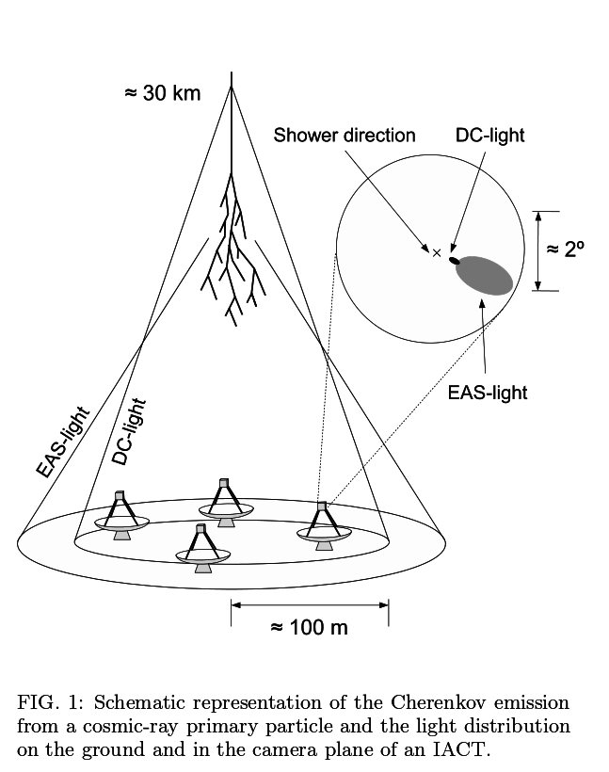
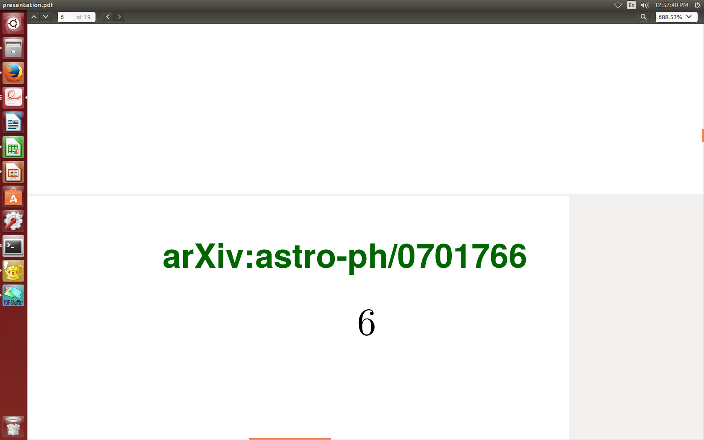
Aim of the analysis
Cosmic Rays Cherenkov Light is imaged by telescopes eg. HESS
Events currently reconstructed with Hillas Analysis
Core position/Charge resolution is poor

Slide 3
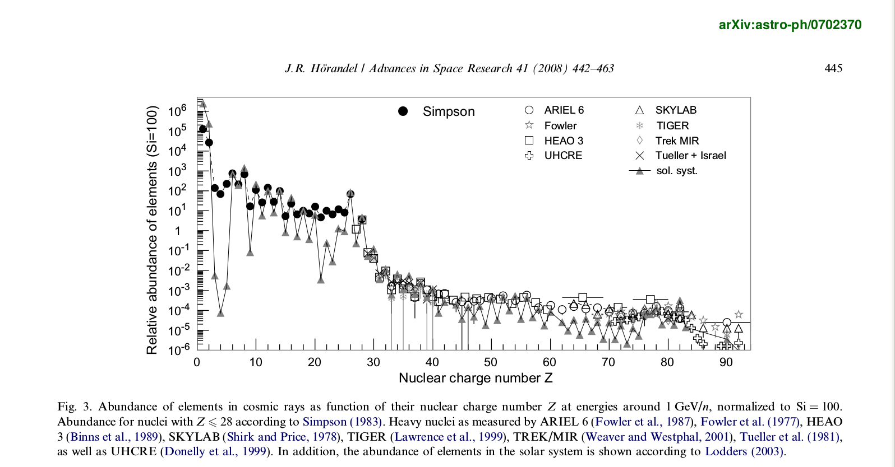

Slide 4
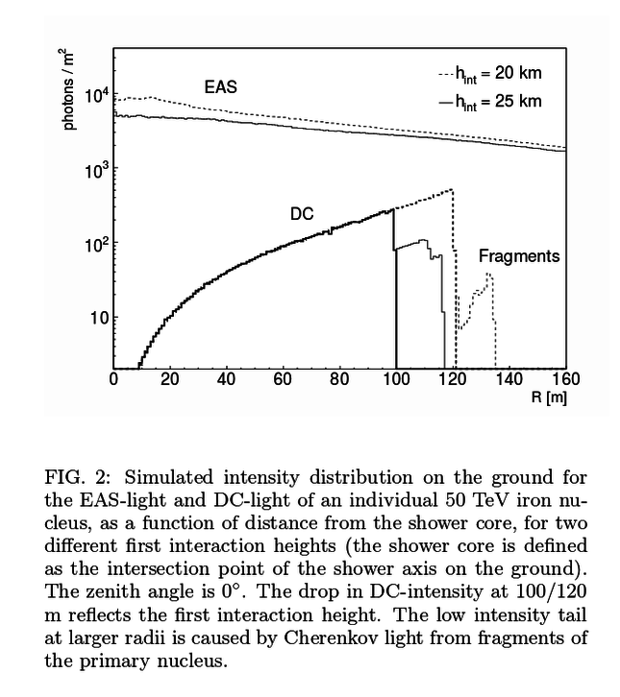
Lateral Photon Distribution Method
New reconstruction method, fitting received DC photons to known Lateral Distribution Function.
Aim is to improve reconstruction of Charge.

Slide 5
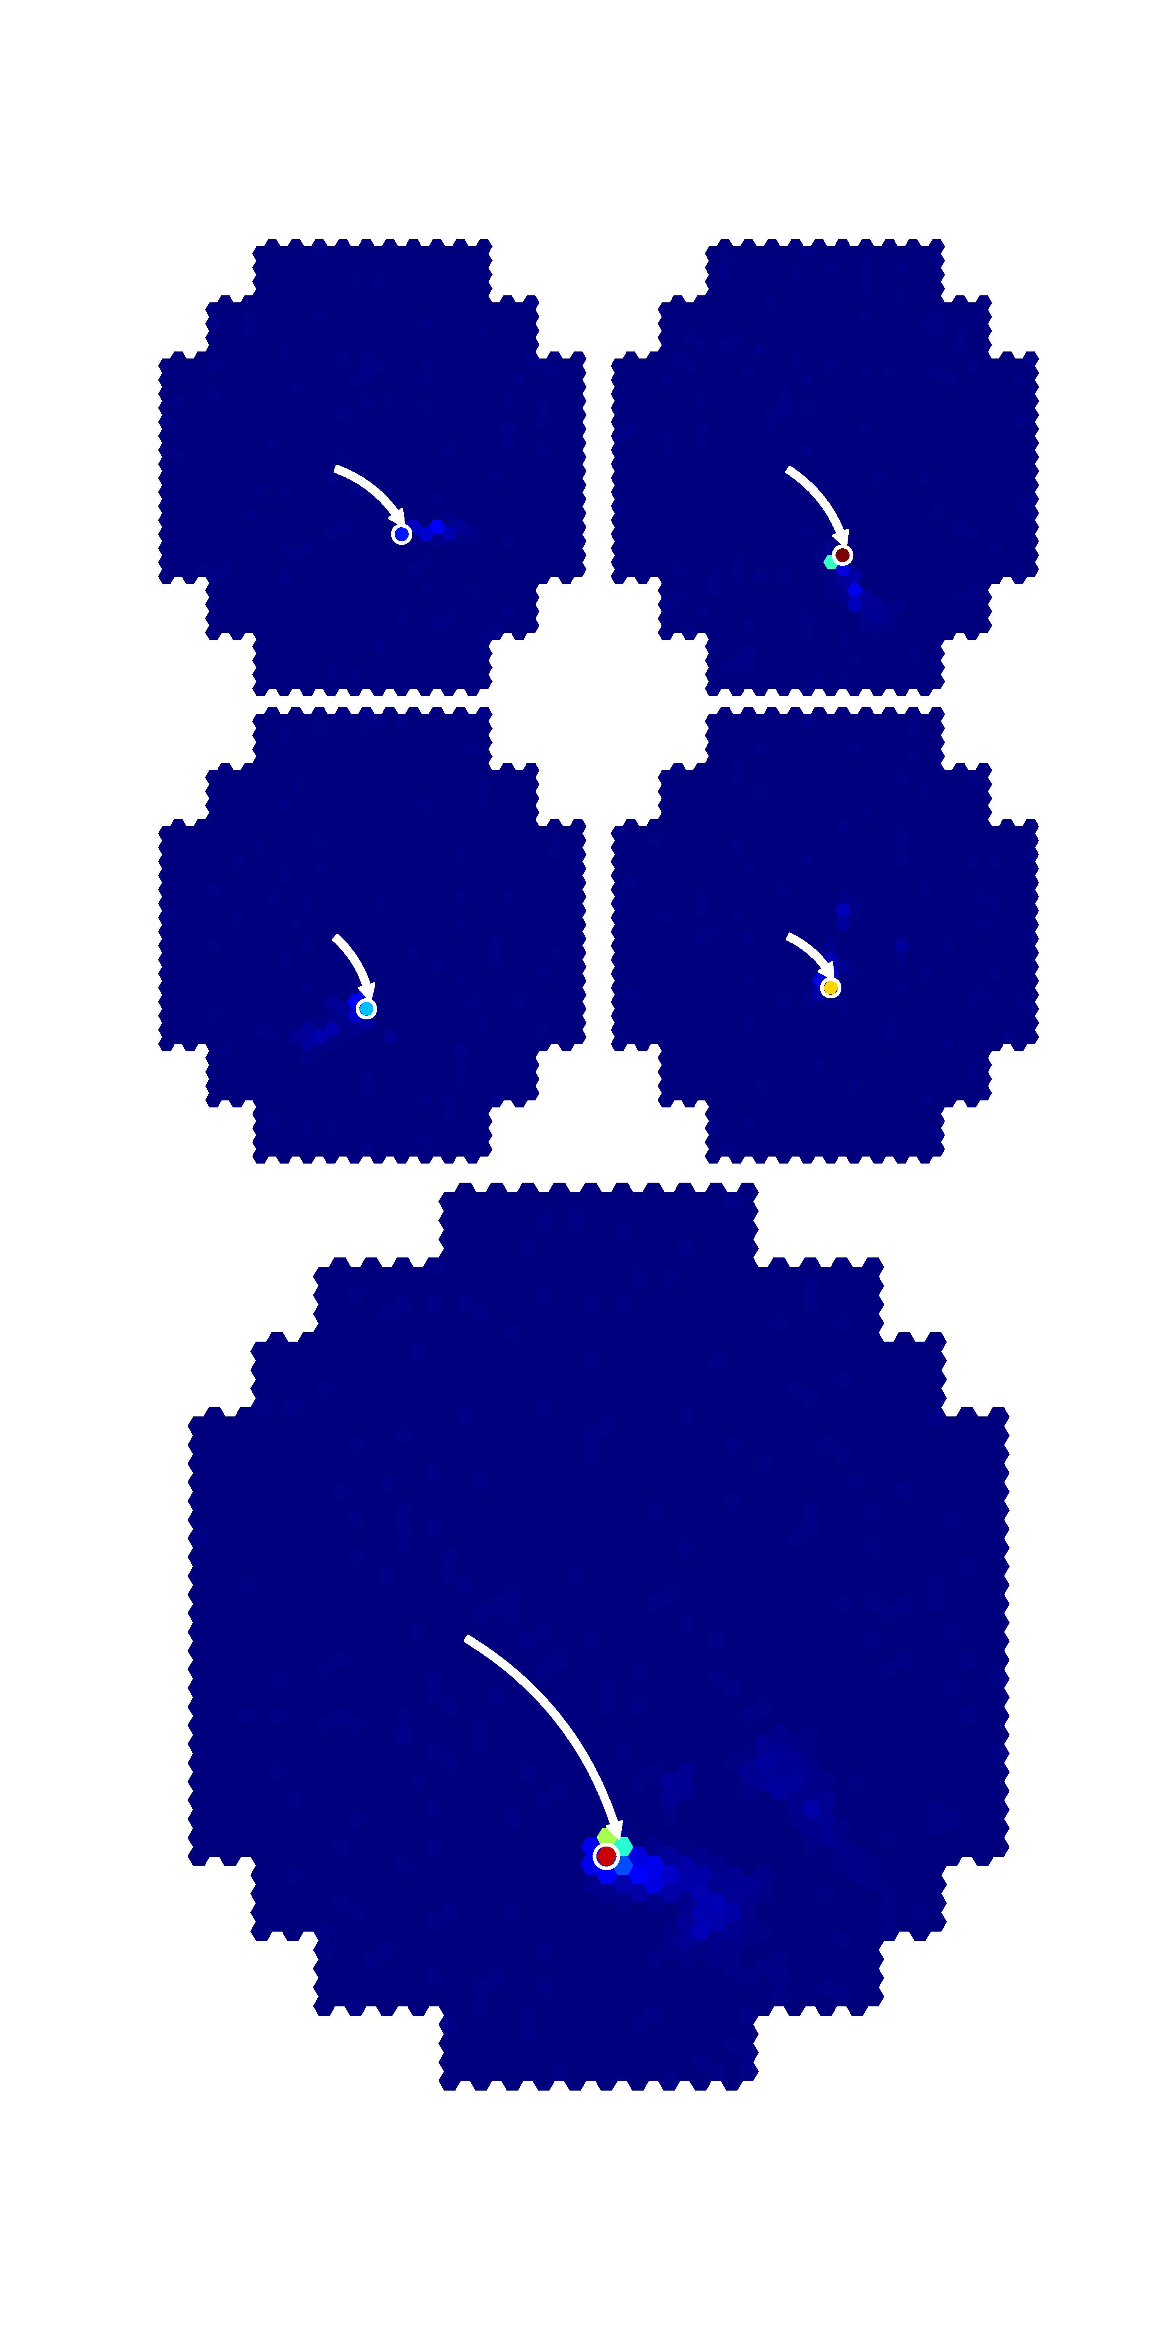
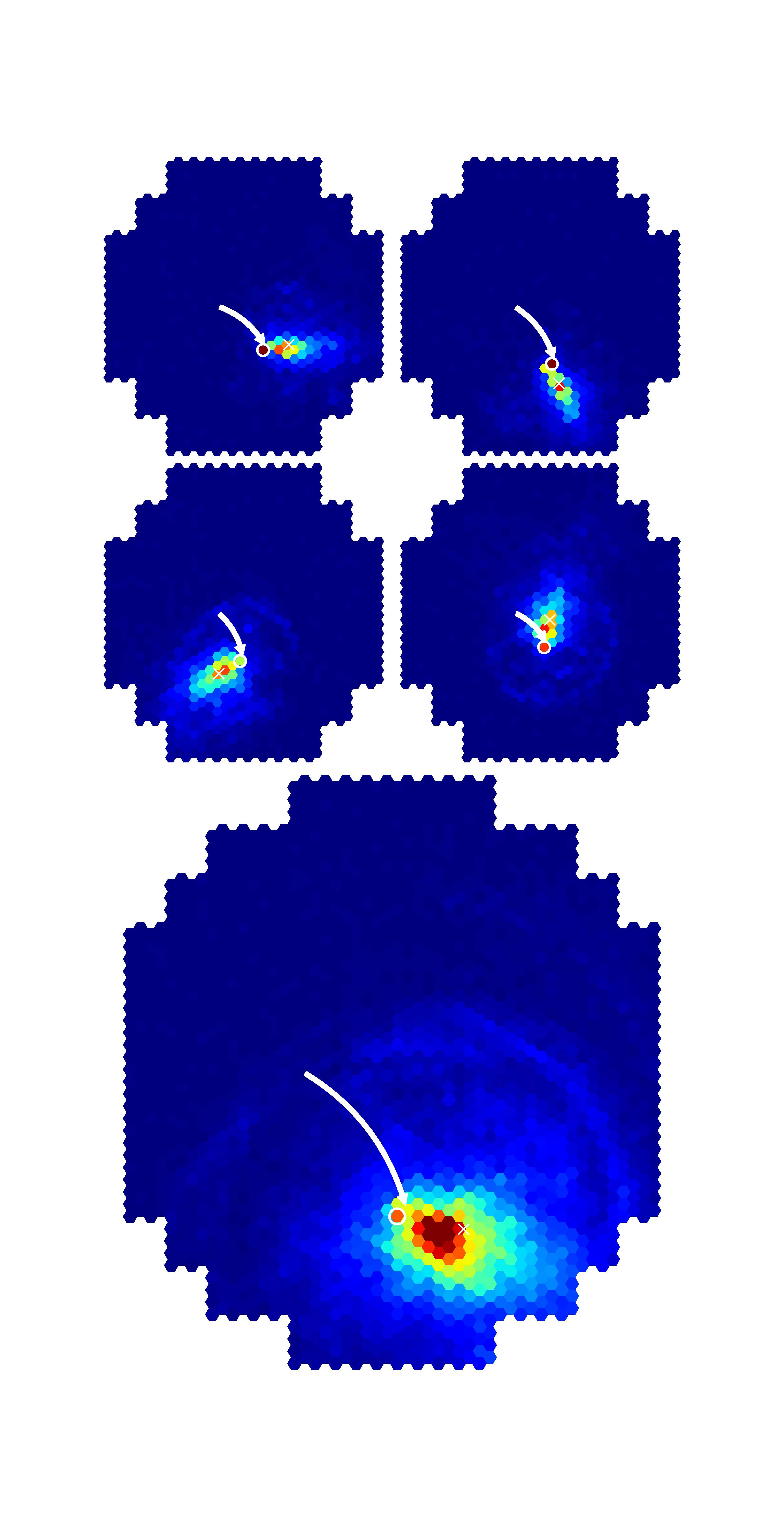

Slide 6
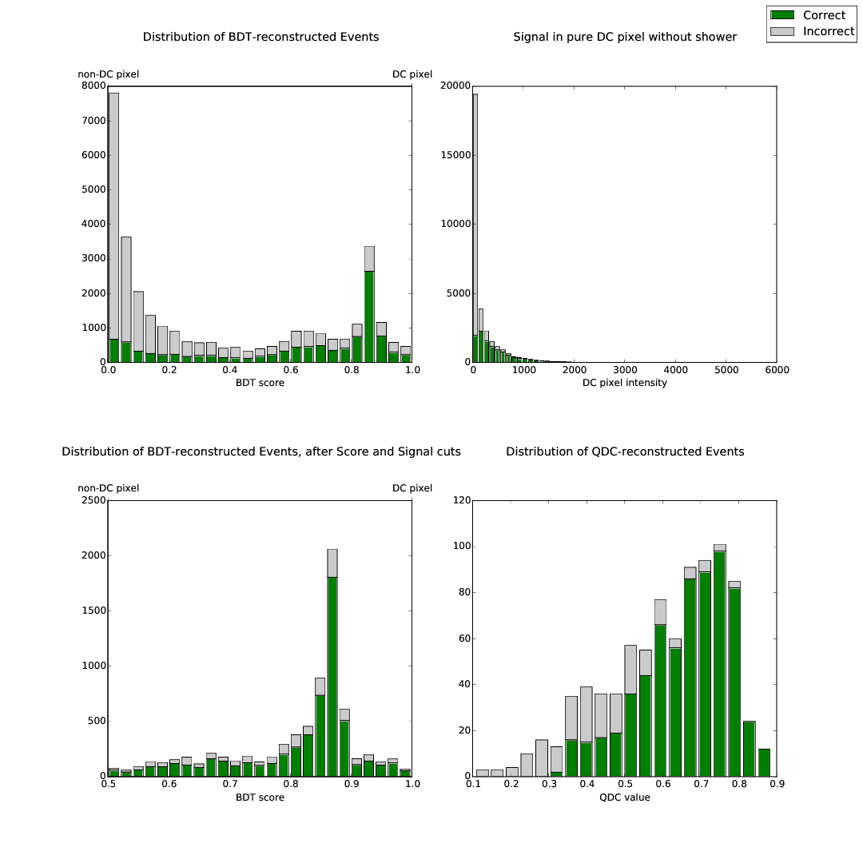

Slide 7
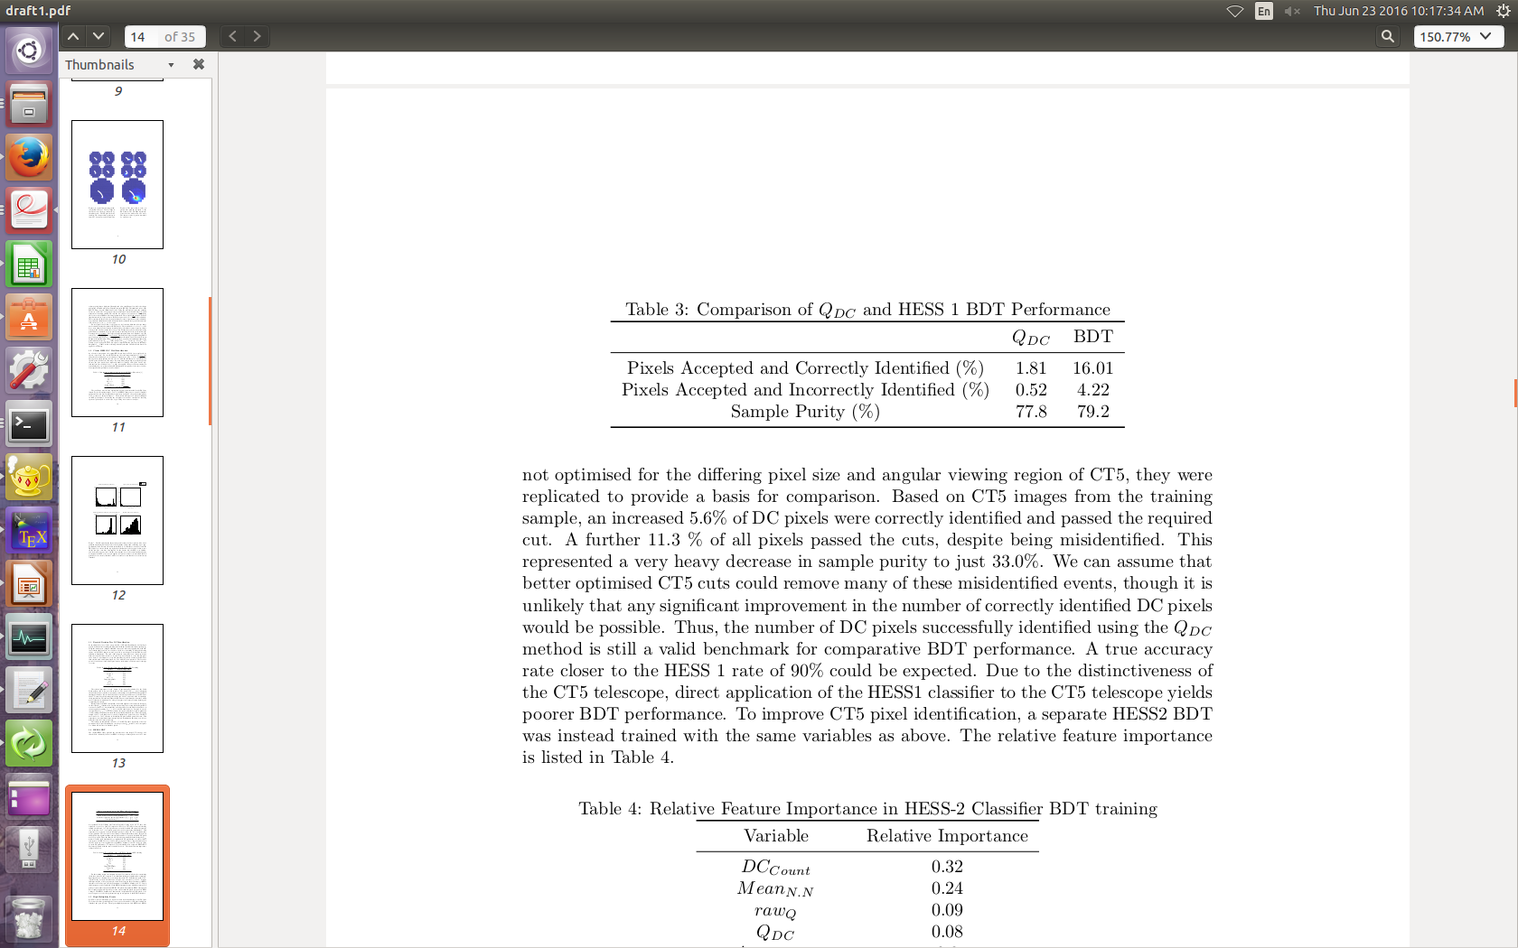
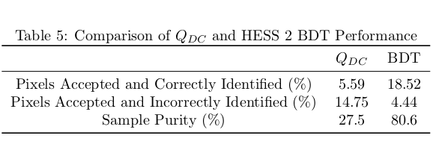
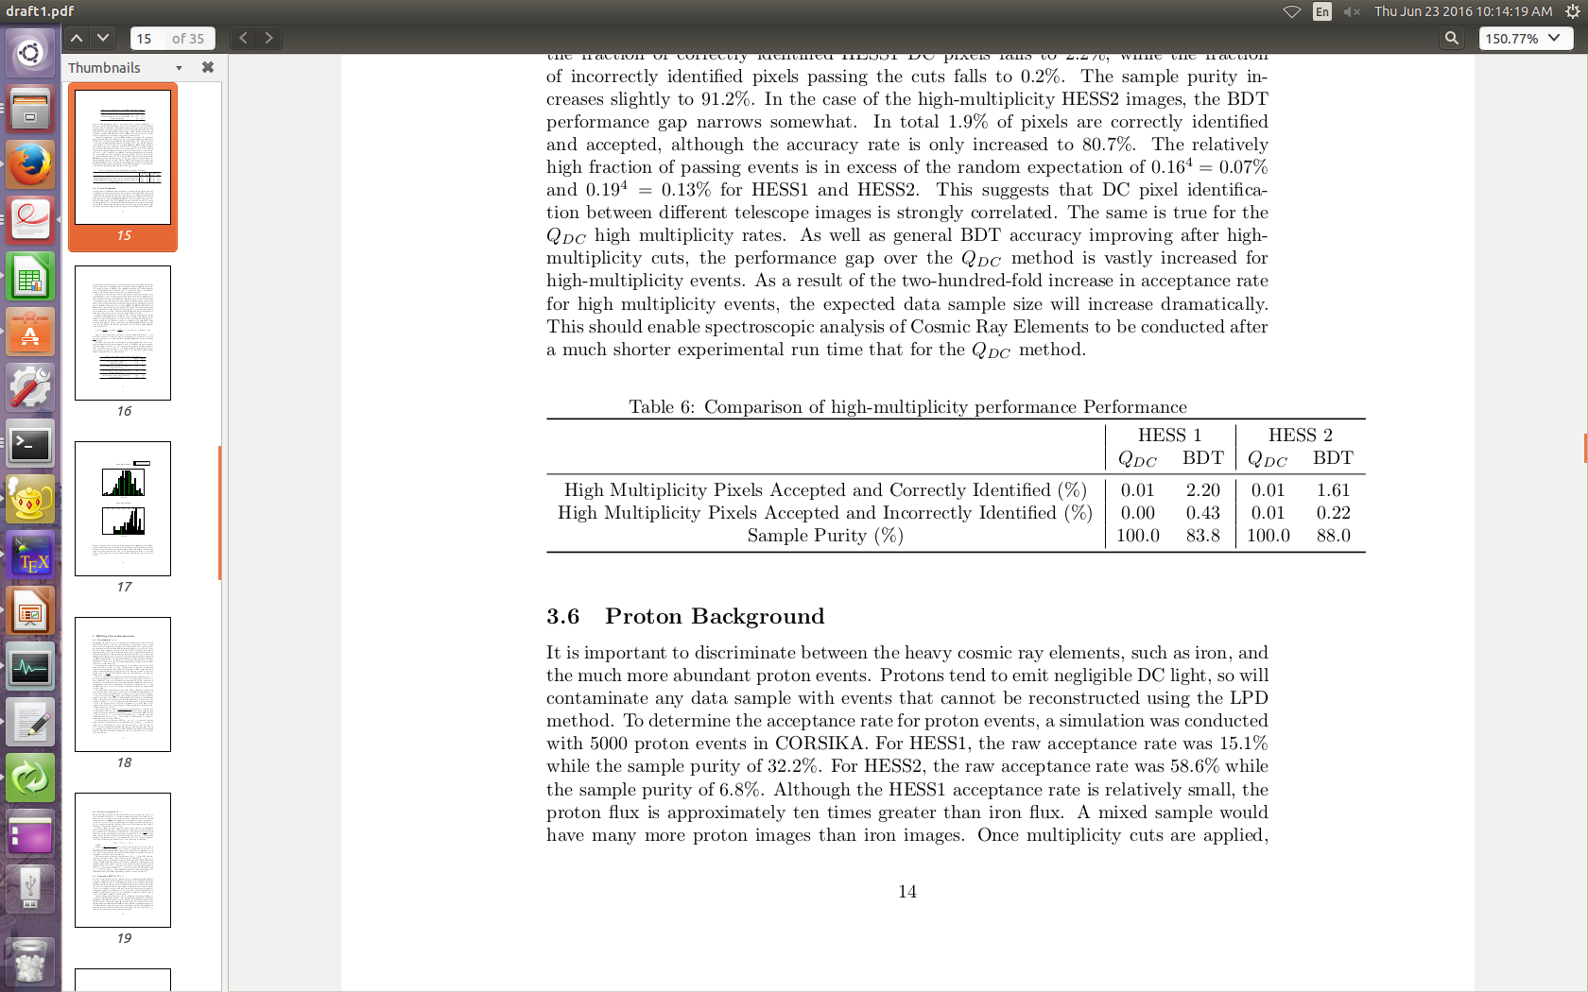

Slide 8
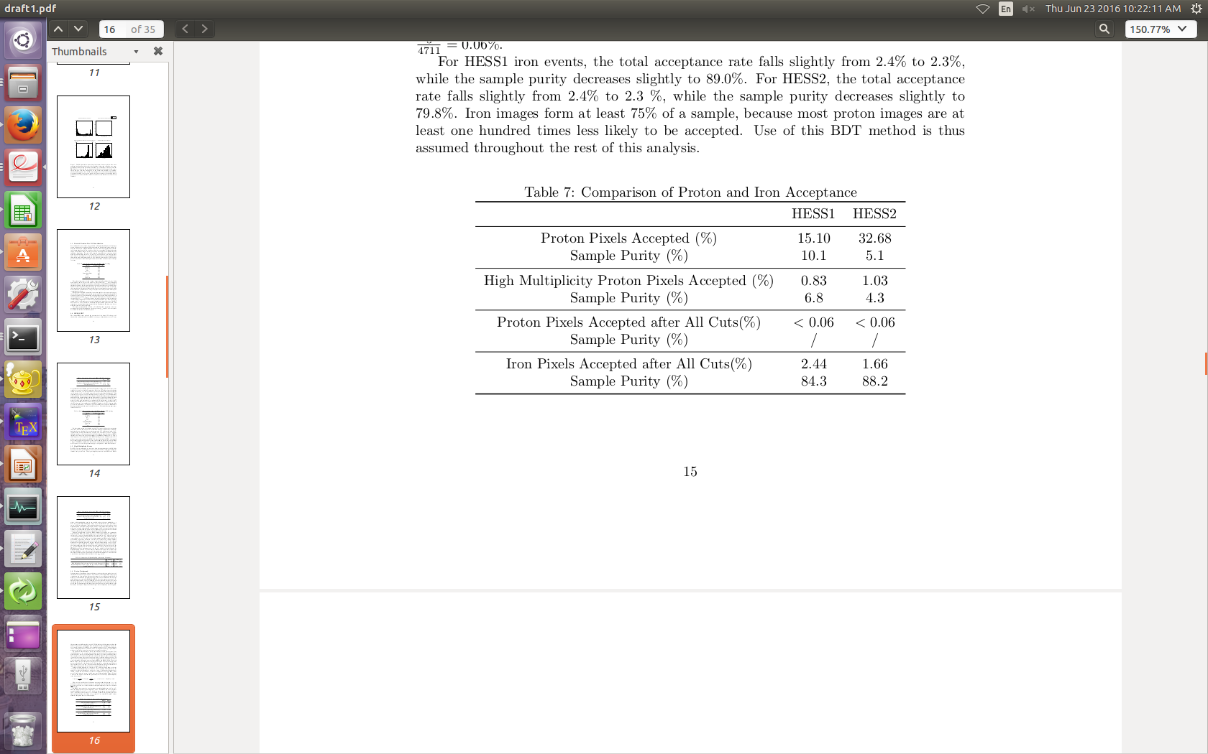

Slide 9
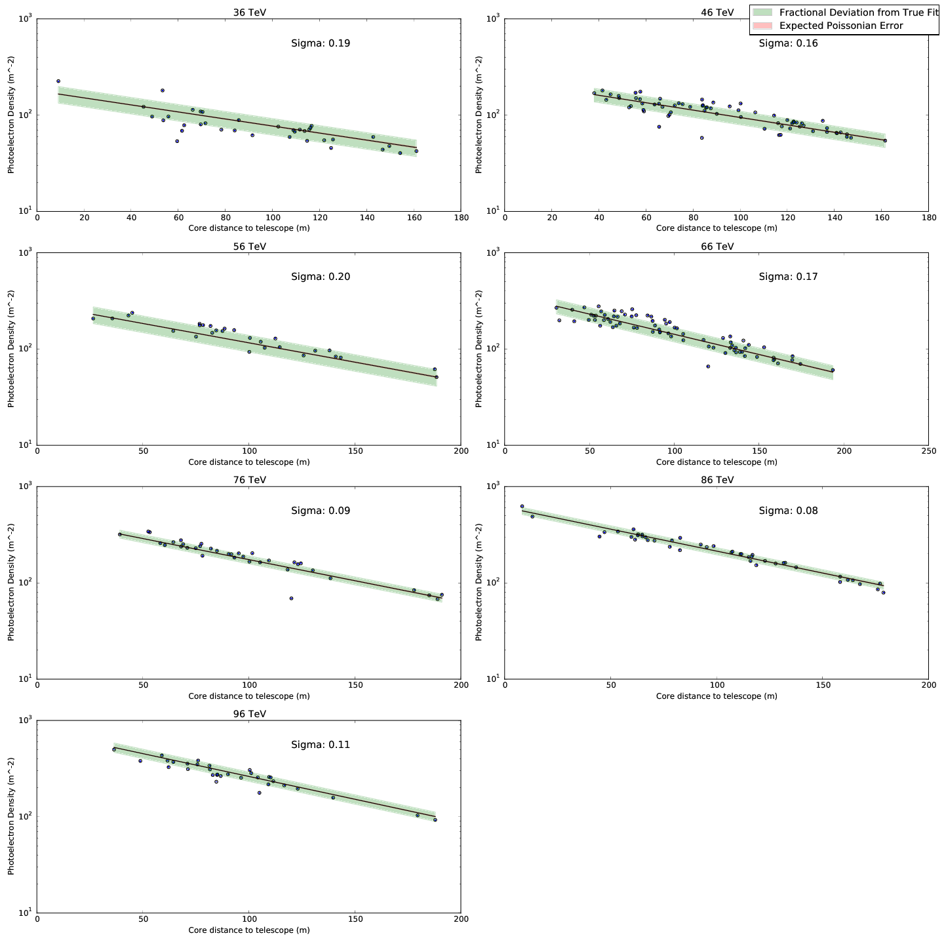

Slide 10
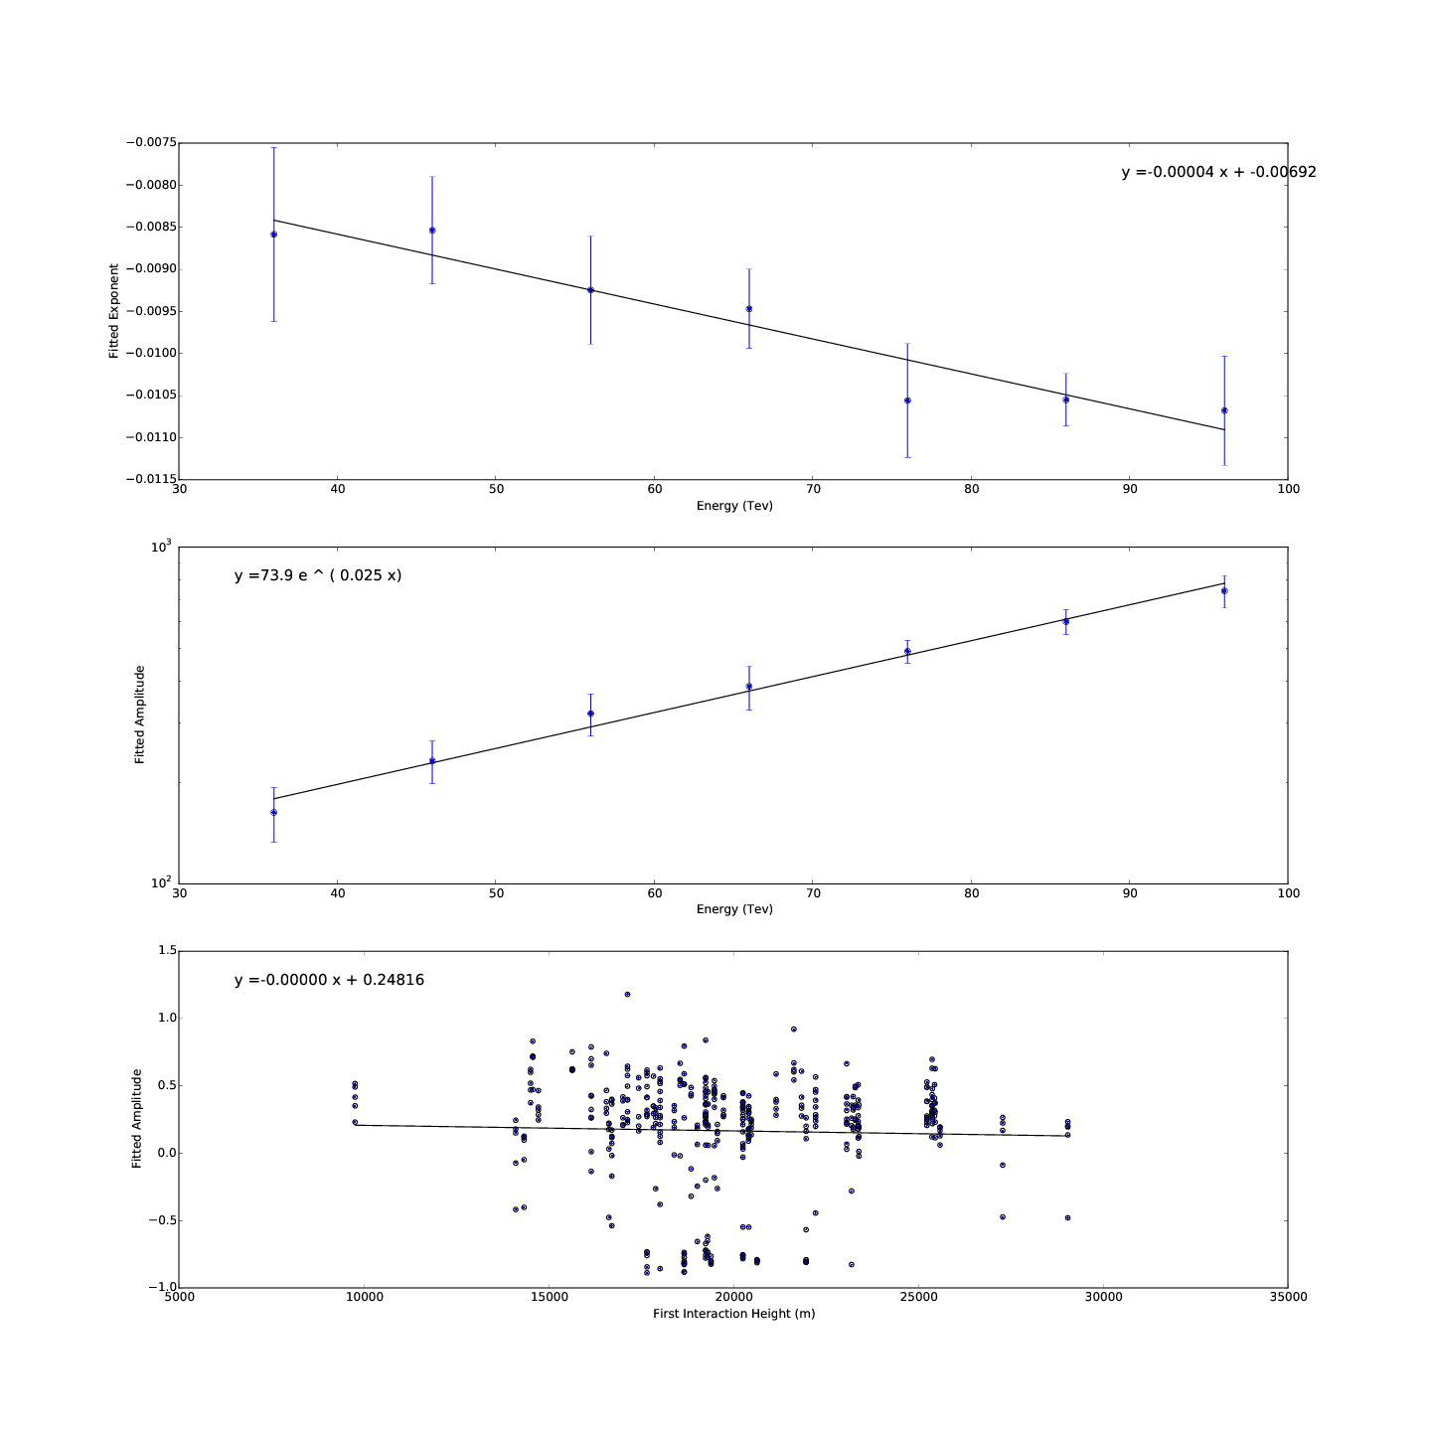

Slide 11
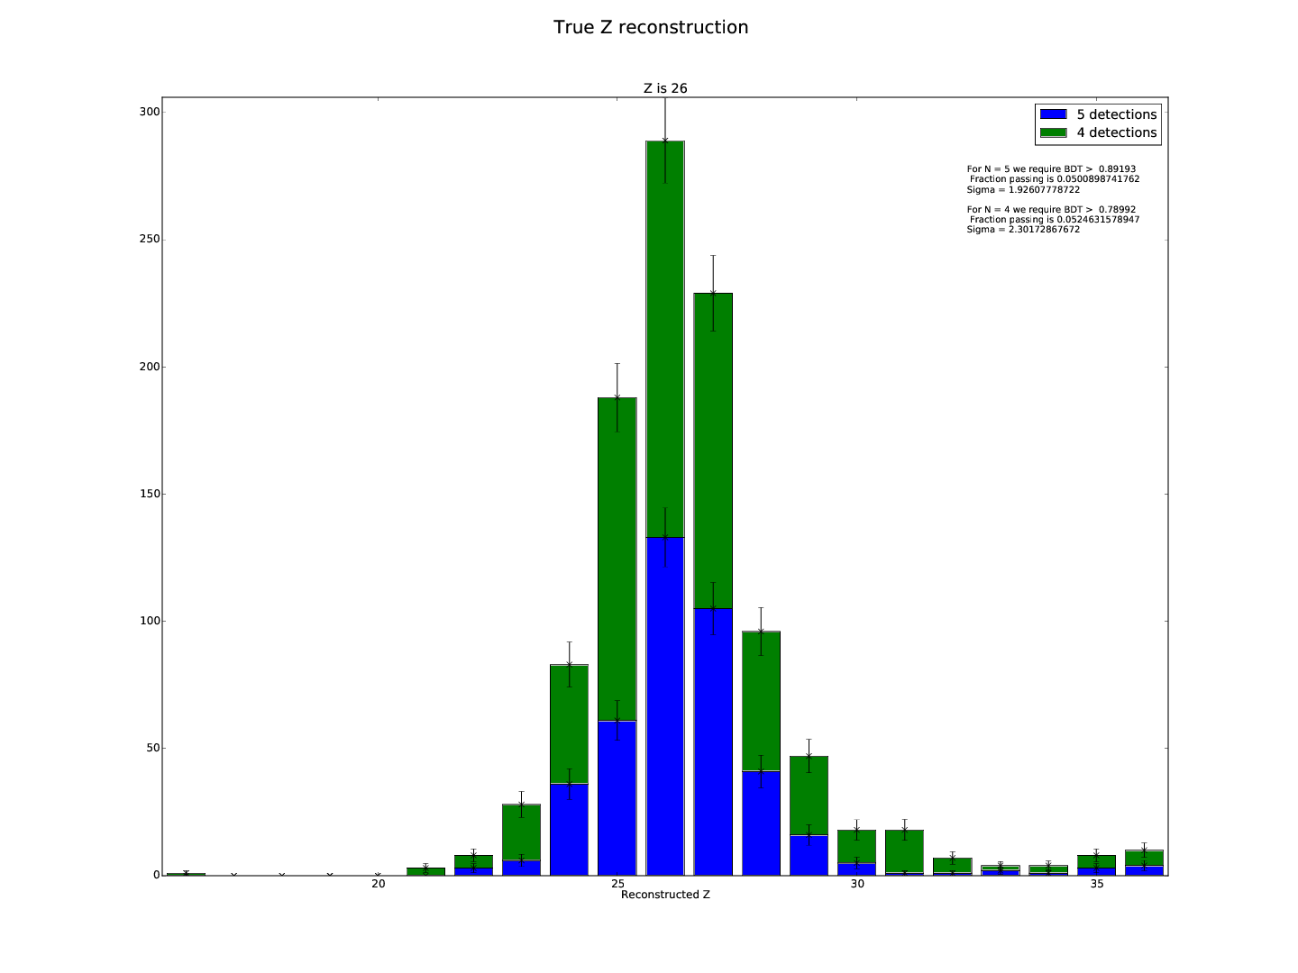

Slide 12
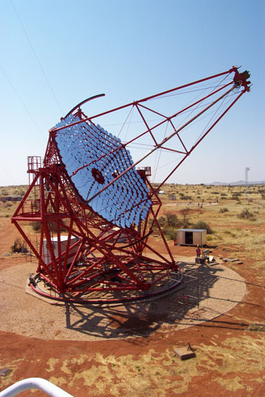
Optimised Telescope Array
Grid of 3 x 3 telescopes (variable grid width X)
Expected counts for 50 hours run time
Minimise σZ by balancing competing effects
X
X

Slide 13


